Slide 1
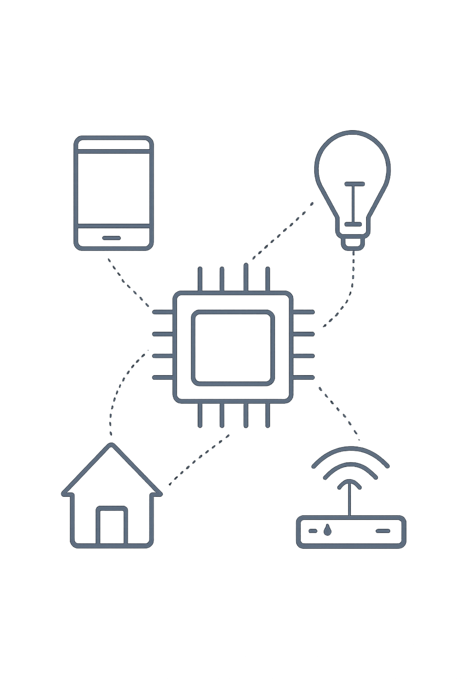
Smart RFID Attendance Tracking System
Review 3 – Methodology Development
Team members: Pranavi - 2510030178, Varshitha-2510030278, Sri Harini-2510030374, Varshitha-2510030400
Context: Continuing from Review 1 & Review 2 — integrating RFID with camera-based face verification, IoT coordination, central database, and dashboard for reliable attendance tracking.

Slide 2


Problem & Proposed Solution
Problem
Proposed Solution
Manual attendance is slow. RFID identifies a card, not necessarily the person holding it — enabling proxy attendance. Records need centralized monitoring.
Two-stage identity check: RFID scan followed by camera-based face verification. Decision requires RFID identity and face match before recording attendance.
Visual flow: RFID Card → RFID Reader → Camera → Face Verification → Attendance

Slide 3
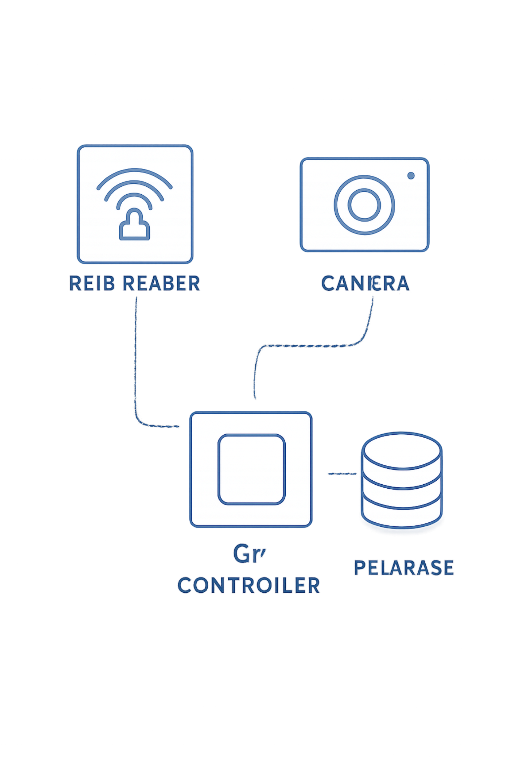

Developed Methodology — System Architecture
Student / RFID Card: card presented at reader
RFID Reader: reads card ID → queries identity
Camera Capture: captures real-time face image
Face Detection / Identification: extract features, identify candidate
RFID + Face Matching: consistency check between card identity and face identity
Attendance Decision: accept only if match; otherwise reject / retry
Central Database: timestamped record
Admin Dashboard: monitoring, reports, and analytics
Attendance is recorded only after identity verification (RFID identity + face match).

Slide 4
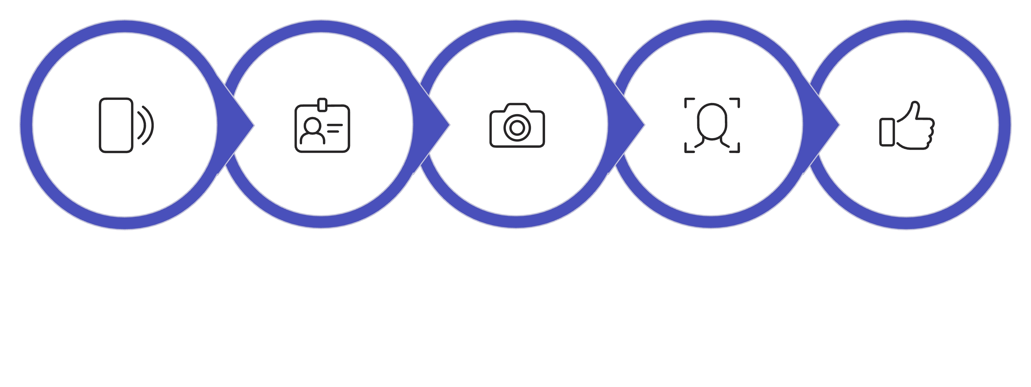
Detailed Working Flow
RFID Scan
Retrieve ID
Capture Face
Verify Face
Decision

Slide 5

Core Novelty: Two‑Stage Identity Verification
Traditional RFID Attendance
RFID Card → Attendance. Vulnerable to proxy use because the card alone determines presence.
Our Methodology (Enhancement)
RFID Card → Face Verification → Identity Match → Attendance. RFID gives fast lookup; face verification confirms the card-holder's identity. Attendance recorded only when both sources agree.

Slide 6
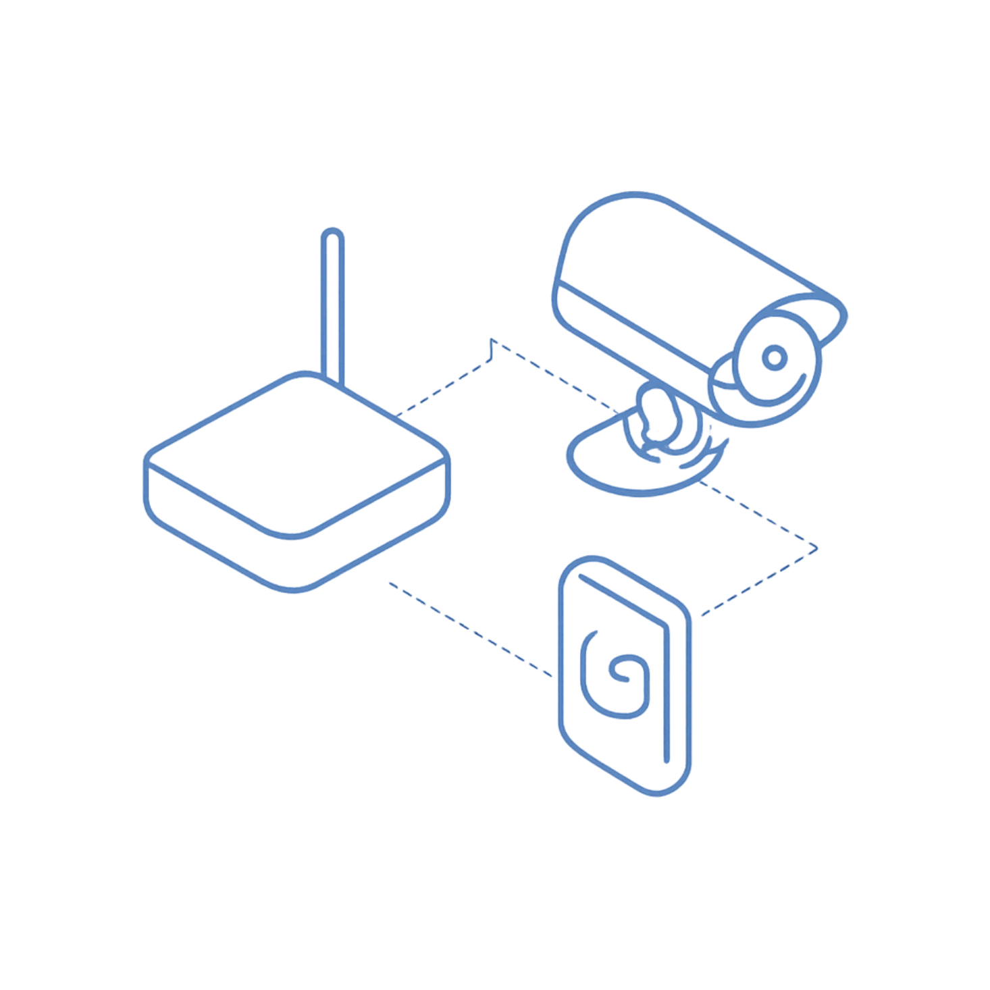
Hardware & Software — Implementation Methodology
Hardware
RFID card
RFID reader
Camera (real-time capture)
IoT / controller unit for orchestration
Software & Data Layer
Face identification / verification module (model pipeline)
Decision logic (RFID ↔ face consistency)
Central database for timestamped records
Admin dashboard for monitoring and export
Components communicate via the controller: reader → controller → camera capture trigger → verification → database write → dashboard update.

Slide 7
Methodology Evaluation & Test Cases
Test Case | Expected Result / Notes
Correct RFID + Correct Face | Attendance Accepted
Correct RFID + Different Face | Attendance Rejected
Unknown RFID | Attendance Not Recorded — flag for admin
RFID Detected + Face Not Detected | Retry capture; if persistent, mark as incomplete
RFID + Face Identity Mismatch | Attendance Rejected; optional manual review
Valid Identity + Duplicate Attendance | Duplicate handling rules applied (ignore or mark duplicate)
Evaluation parameters (planned): RFID read rate, face verification correctness, RFID–face matching correctness, attendance recording correctness, response time, proxy-attempt rejection, and database update reliability.

Slide 8



Adaptability & Applications
Colleges & Universities
Schools & Training Institutes
Offices & Restricted Areas
Lecture halls, labs, tutorial sessions — scalable room deployments.
Class-level installations with lighter-weight hardware and simplified dashboards.
Adapted to access control or shift attendance with environment-specific thresholds.
Methodology pattern remains: Identification → Face Verification → Decision → Database → Monitoring. Components can be tuned per environment (camera angle, retry logic, privacy settings) without changing the core methodology.

Slide 9
Dissemination, Accessibility & Current Status
Dissemination & Accessibility
Current Development Status
Planned GitHub repository with source code and setup instructions
System architecture diagrams and workflow documentation
Prototype demonstration materials and user guide
Completed / Proposed
Problem identification
Literature survey
RFID attendance concept
RFID + face verification concept
System architecture
Methodology design
Next Implementation
Hardware integration (readers, cameras, controller)
Camera capture & face verification implementation
Database integration & schema design
Dashboard development
End-to-end testing and evaluation

Slide 10
Conclusion & References
Conclusion
Next Steps
RFID provides fast identification; camera-based face verification adds a second identity check. Combined RFID + face matching reduces proxy attendance risk and supports centralized monitoring. Planned evaluations will measure verification accuracy, response time, and reliability.
Integrate hardware, implement verification pipeline, run planned test cases, and publish repository/documentation for reproducibility.
Selected References (from Review 2)
Lim, Sim & Mansor (2009)
Putra, Loppies & Zubaedah (2021)
Mohammed et al. (2018)
Ishaq & Bibi (2023)
Smart Attendance System using Face Recognition and RFID Technology (2021)
Ardianto (2025)
Retain DOIs/arXiv entries from Review 2 in the final document where applicable.

